Slide 1

Profiling Household Energy Consumption
TEAM - H
Abhishek Jain
Bo Wang Rashmi Upadhyaya
Yuyue Jiang

Slide 2
Data set and Problem Statement
Dataset for Residential Energy Consumption Survey taken in 1995 -
Household data - Demographic informations of people like age, income, employment etc. (29 features and 4382 rows)
Housing data - type of neighborhood the house is located in, the total area of the house and the area air conditioned, area heated etc
(30 features and 4382 rows)
Energy
consumption data - annual household consumption of energy like electric energy, gas, fuel etc. (32 features and 4382 rows)
Relevant dataset for electric energy consumption study (51 features and 4381 rows)
Data Cleaning removing missing values and columns not relevant for study
What are the features that are affecting the consumption of electricity?
How to clearly distinguish ‘low’ and ‘high’ consumers?
Notes:
The three datasets we were presented with was from an Energy consumption survey in 1995. It provided us information on households – demographics of people living in the house, income, employment info etc. Housing data had information on the neighborhood of the house, area under air conditioner heater etc. Energy consumption had annual consumption info, info on various energy consumed like ---. Out of 91 features we had we picked up the relevant features and ignored features which had more than 95% invalid values and our final dataset. From the data provided we are trying to identify ---

Slide 3
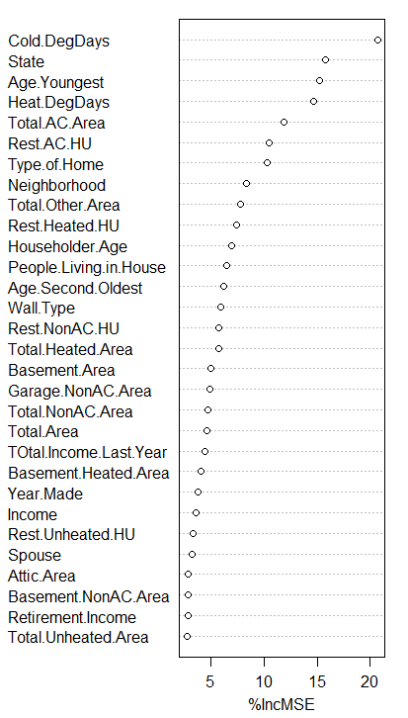
Features contributing most to electricity consumption : Prediction
Method Tried | R Squared Value | Root Mean Squared Error (Million BTU)
All features(51) + Linear Regression | 0.4039074 | 19761.77
All features(51) + Random Forest Regression | 0.41034 | 19688.58824
Random Forest Features (39) + Linear Regression | 0.39824 | 19908.89437
Random Forest Features (39) + Random Forest Regression | 0.4120824 | 19631.4
PCA + Backward Selection (87 features) + Linear Regression | 0.4069159 | 19706.16
PCA + Backward Selection (87 features) + Random Forest Regression | 0.395088 | 19916.23
All features(51) + Default Prediction | -0.001800609 | 25638.44
Best tree features selected for prediction on tuning - Number of trees = 101
Mtry = 17
Nodesize = 16
Maxnodes = 100
Notes:
For predicting features which affected energy consumption most, we tried out different models as shown in the table. We got best results from Random forest for feature selection and random forest for regression. We picked up the top 39 features from the variable importance plat as shown on the right and that gave us the lowest RMSE.

Slide 4
Top features identified for energy consumption
Characteristic of House | Characteristic of Residents | Other Factors
Total Area under Air Conditioner | No of people living in House | Hot/Cold Degree Days
Total Area of Home | Total Combined Income | Type of Home
Total Heated Area | Other Activity at Home like business | State
Type of Walls
Type of Neighbourhood
Notes:
So, to reduce energy consumption, we would have to take care of these features in specific.

Slide 5
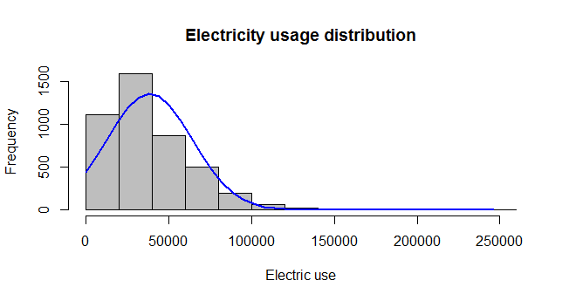
‘High’/’Low’ Electricity Consumers : Classification
Cutoff = Median of values between 0 to 100,000 = 38650
Energy consumption > 38650 ( in thousands of BTU) - high
Energy consumption < 38650 ( in thousands of BTU) - low
Models Used for classification to obtain
results –
1) K Nearest Neighbour
2) SVM
3) Naive bayes
4) Random Forest
5) Logistic Regression
6) Default Classifier(BaseLine)
Notes:
For classifying consumers into ‘high’ and ‘low’ electricity consumers we set a cutoff of 38650 thousands of BTU. We used the following model for addressing this classification problem.

Slide 6
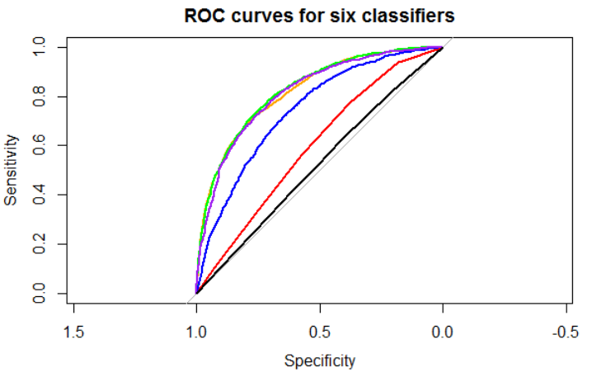
Results
Highest TPR and AUC. SVM gives the best results!
ROC curves:
K-NN,naive bayes,support vector machine, logistic regression, randomForest.

Slide 7
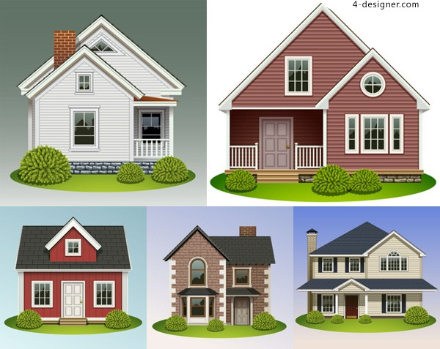
How does this information help?
Housing Societies :
What features to take into consideration while starting a construction new project:
Consumers : Features to look for when buying a new house
Source : http://remagazine.coop/power-theft/
Notes:
How and whom does this information help? Who can use these? Housing socities can take these features into consideration when starting a new project. An individual looking to buy a new house should also pay attention to these as electricity bills are fixed monthy cost.

Slide 8
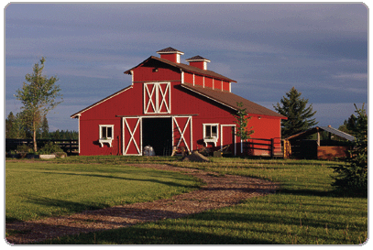
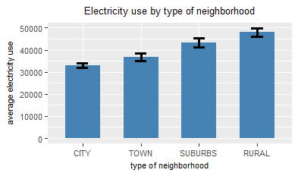
How does this information help?
Rural area averagely consumes more electricity.
Help them update the appliances’ energy efficiency
Notes:
The study also indicated that houses in rural areas consumed maximum amount of electricity – possibly because they have bigger houses or they still use outdated appliances. This information could be useful for all electricity efficient appliances sellers to identify their potential market.

Slide 9
How does this information help?
The government:
implement a tiered pricing system for household electricity.
Predict electricity consumption, keep updating the pricing system.
Tier one:
<19770
13.76 cents
Tier two:
19770 to 49630
14.76 cents
Tier three:
> 49630
16.76 cents
Notes:
Our recommendation is government uses tiered pricing system as shown. Different pricing for different brackets of electric energy consumers. This couls push people tp reduce their electricity consumption usage.

Slide 10

How does this information help?
Help government identify electricity theft :
As much as $6 billion lost annually in US!
Source : http://remagazine.coop/power-theft/
Notes:
Most importantly, this could also help government identify any abnormally high usage of electricity. Every year US loses 6 billion $ worth of electridity to electricity thefts!

Slide 11
Thank You

